Slide 1
Complex Logic and Composition

Slide 2

Weekly Announcements!
TODO Reminders:
Reading 8 (zybooks) – you should have already done that ☺
Lab 05 – self explanation needs to be done in lab
Reading 9
Lab 06 – peer-interaction needs to be done in lab
Reading 10 (zybooks)
Keep practicing your RPAs in a spaced and mixed manner ☺

Slide 3
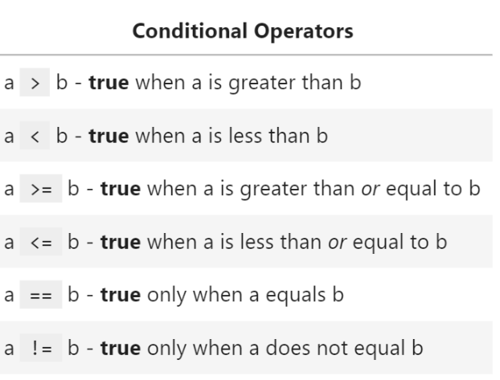
Review: Conditionals Operators

Slide 4
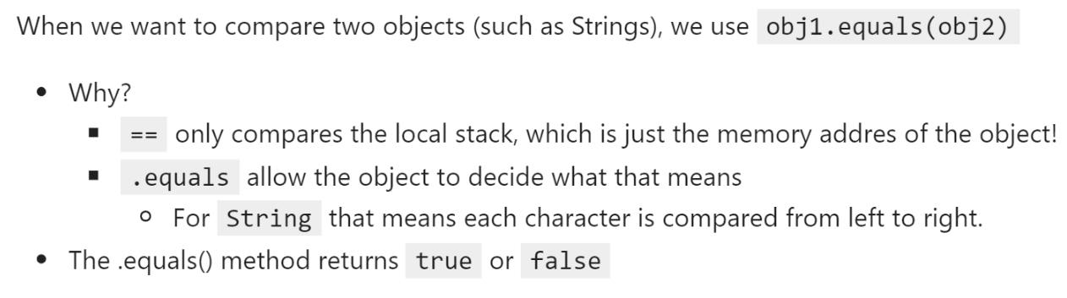
Review: Conditionals Operators
How can we combine different conditions?
Use Logical Operators to do Complex Conditional!

Slide 5
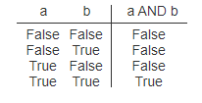
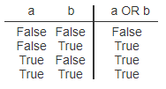
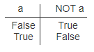
Complex Conditionals
All must be true
At least one must be true
Negates the original condition

Slide 6
Logical Operators
Logical and - &&
All must be true
int puppyCounter = 10;
if(puppyCounter > 5 && puppyCounter < 10) {
System.out.println(“Yay, puppies”);
}
Logical or - ||
Any statement can be true
Continues checking even if false
String cmd = “exit”;
if(cmd.contains(“x”) || cmd.contains(“X”)) {
System.out.println(“Goodbye”);
}

Slide 7
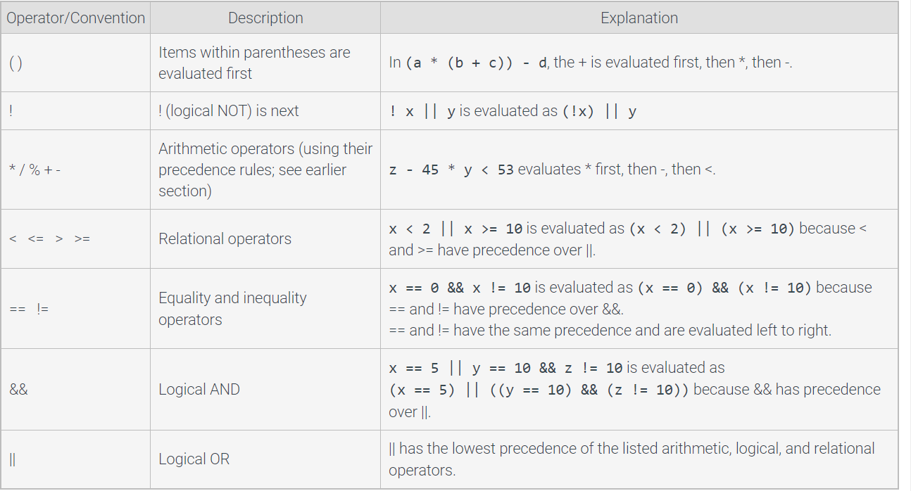
Precedence rules for arithmetic, logical, and relational operators

Slide 8
Logical Operators – In Class Activity - Attendance
Only compare true or false
Every statement on each side must evaluate as true or false to use the logical operation.
Mark valid or invalid for the statements below and explain your answer:
A)
!((4 + 1) < (2 * 0))
A)
B)
10/2 > 5 || (3 + 4) < 10 && true
C)
10 > 5 && 10

Slide 9
Review
Conditional Operators
Compare primitives
Objects need methods
equals
equalsIgnoreCase
Logical Operators
Compare boolean only – true and false
As such, everything must evaluate to true or false before they are used

Slide 10
Composition
A composition in Java between two objects associated with each other exists when there is a strong relationship between one class and another.
For example, one class has an attribute that is an object of another class.

Slide 11
Composition: Example
public class Library { private Book book1; private Book book2; private Book book3; public Library(){ book1 = null; book2 = null; book3 = null; } public boolean addBook(Book book){ if(book1 != null && book2 !=null && book3 != null) return false; if(book1 == null) book1 = book; else if(book2 == null) book2 = book; else if(book3 == null) book3 = book; return true; } public String toString(){ String msg = ""; if(book1 != null) msg += book1 + "\n"; if(book2 != null) msg += book2 + "\n"; if(book3 != null) msg += book3 + "\n"; if(msg.equals("")) msg = "No books in the library!"; return msg; } }
Instance variables
public class Book { // Instance variables --> attributes private String title; private String author; // Constructor of this class public Book(String title, String author) { this.title = title; this.author = author; } public String toString(){ return "Title: " + title + " Author: " + author; } }
Constructor

Slide 12
Composition: Example
public class AppLibrary { public static void main(String args[]){ Library lib = new Library(); System.out.println(lib.toString()); Book b1 = new Book("Death on the Nile", "Agatha Christie"); if(lib.addBook(b1)) System.out.println("Book added!"); else System.out.println("No more space in the library!"); System.out.println(lib.toString()); } }

